Slide 1
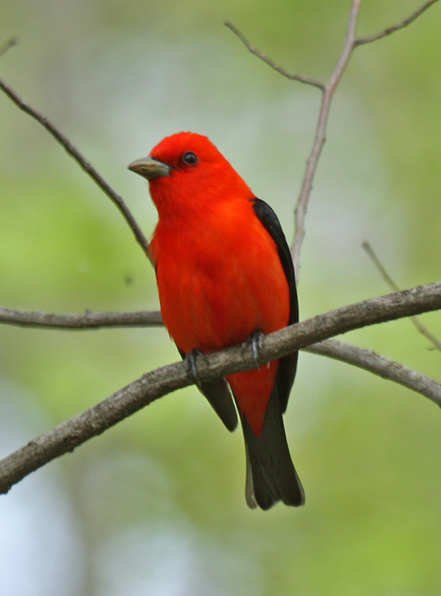
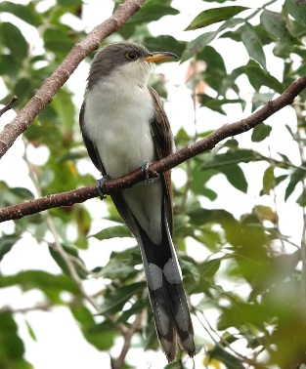
Bird-habitat associations in south-central Iowa
Benjamin M. West
Benjamin M. West

Slide 2
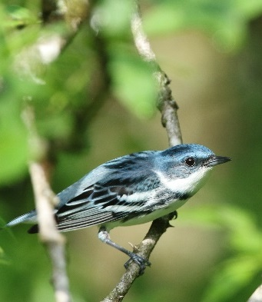
Forest Birds
Deciduous forests in the Midwest are home to >120 species of breeding birds
Vegetation at a variety of spatial scales drives distributions and densities
>60% of “eastern” deciduous forest species in decline

Slide 3
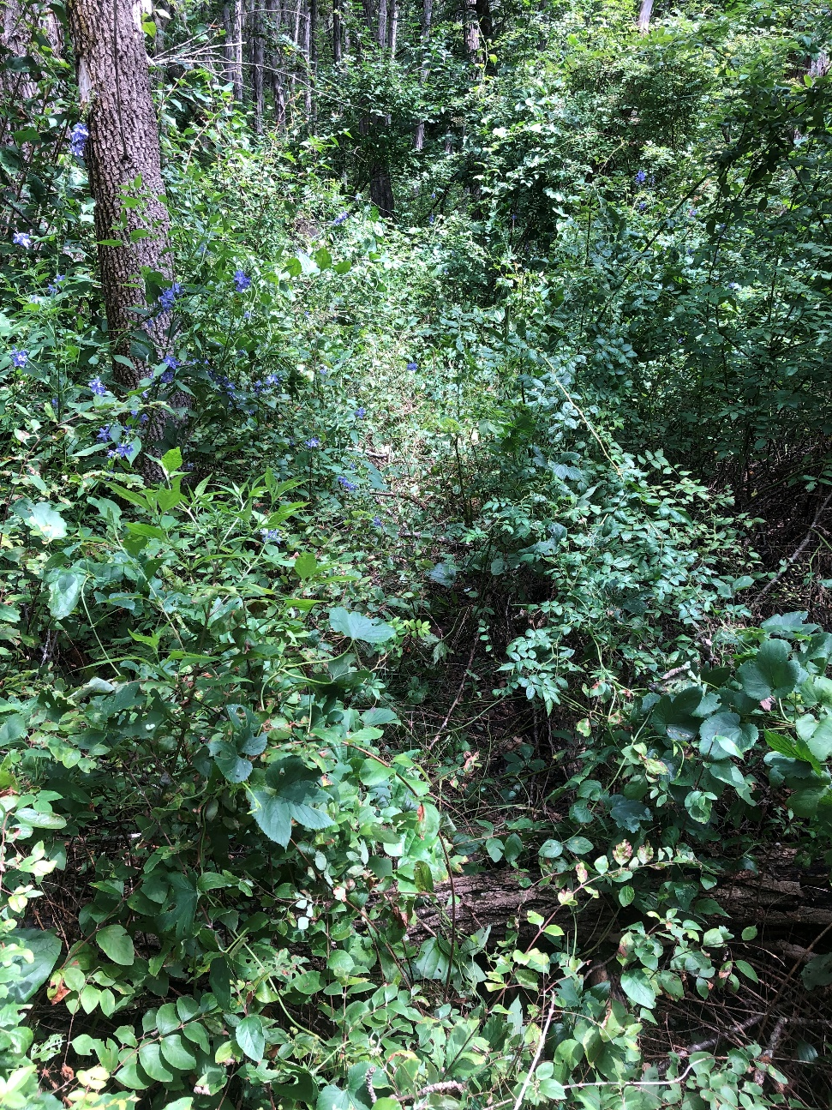
Forest Birds and Human Activity
Negative effects
Deforestation and fragmentation
Suburban and agricultural disturbance
Conversion to even-age monoculture
Positive effects
Reforestation
Partially thinning canopy trees

Slide 4
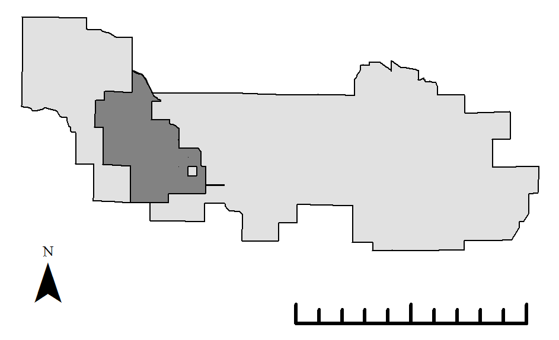
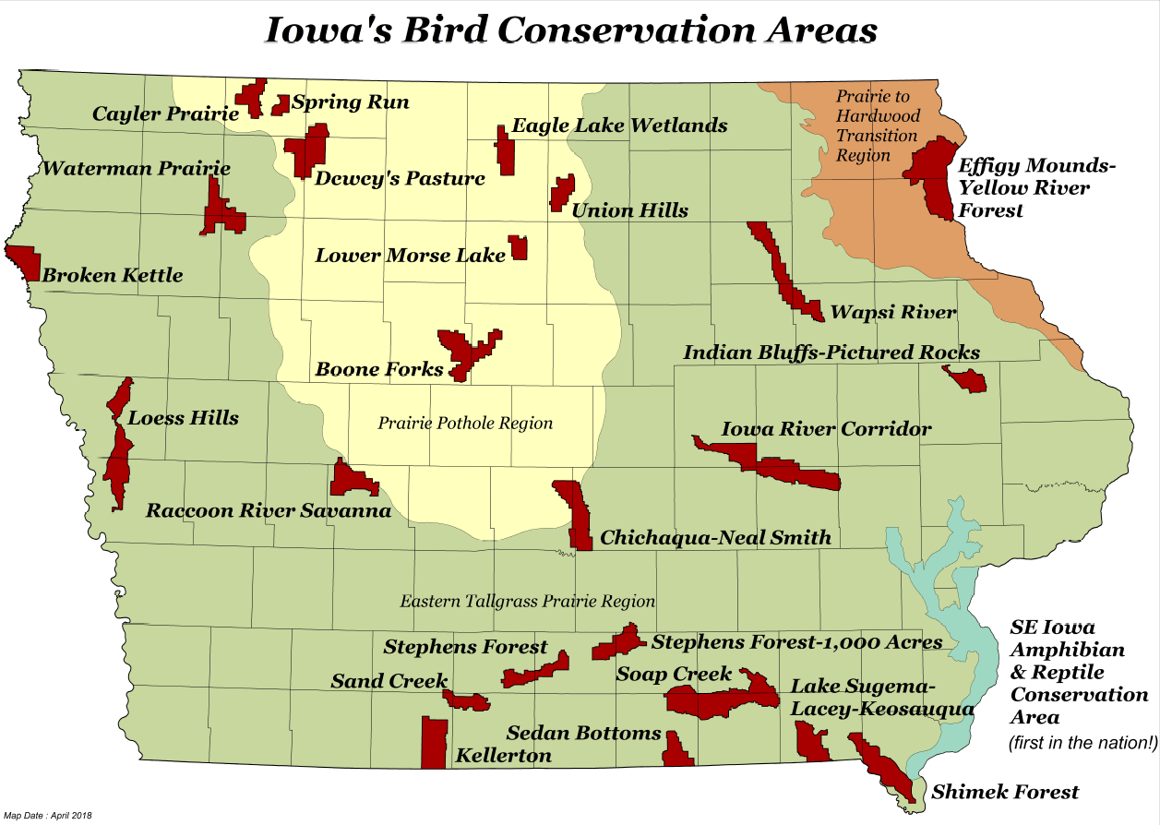
Bird Conservation Areas (BCAs)
Protected core habitat
Private/public land with some habitat
0
5
10 km

Slide 5
Goals
Focus on public cores of three primarily forested BCAs in south-central Iowa
Quantify bird populations and the overall bird community
Determine bird-habitat relationships in these areas
Special focus on Iowa Species of Greatest Conservation Need (SGCN)
End goals: aid development of a local birding trail and inform forest management

Slide 6
Thesis Objectives
Chapter 1: Estimate densities of breeding avian SGCNs and other species of management interest.
Chapter 2: Determine relationships between breeding bird densities and habitat metrics.
Chapter 3: Quantify bird diversity while accounting for imperfect detection probability, and determine relationships between bird diversity and habitat metrics.

Slide 7
This Presentation
Chapter 1: Estimate densities of breeding avian SGCNs … (showing a few density maps)
Chapter 2: Show relationships between breeding bird densities and habitat metrics for four species.
Chapter 3: Quantify bird diversity while accounting for imperfect detection probability and determine relationships between bird diversity and habitat metrics.

Slide 8
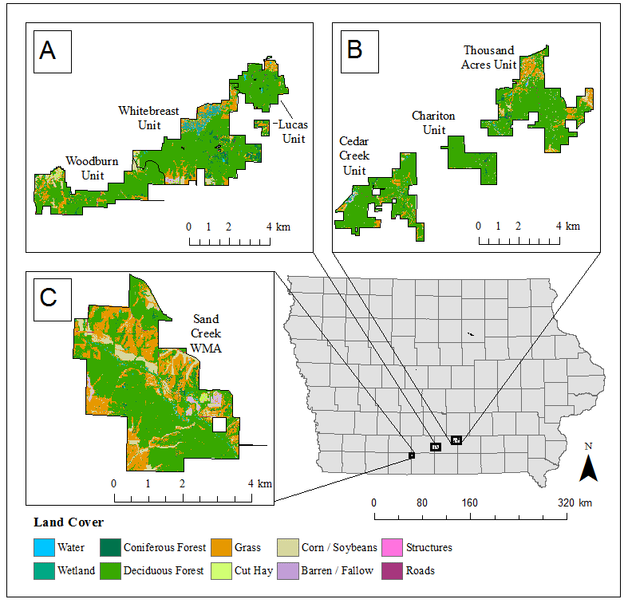
Study Area
Stephens Forest BCA
Thousand Acres BCA
Sand Creek
BCA

Slide 9
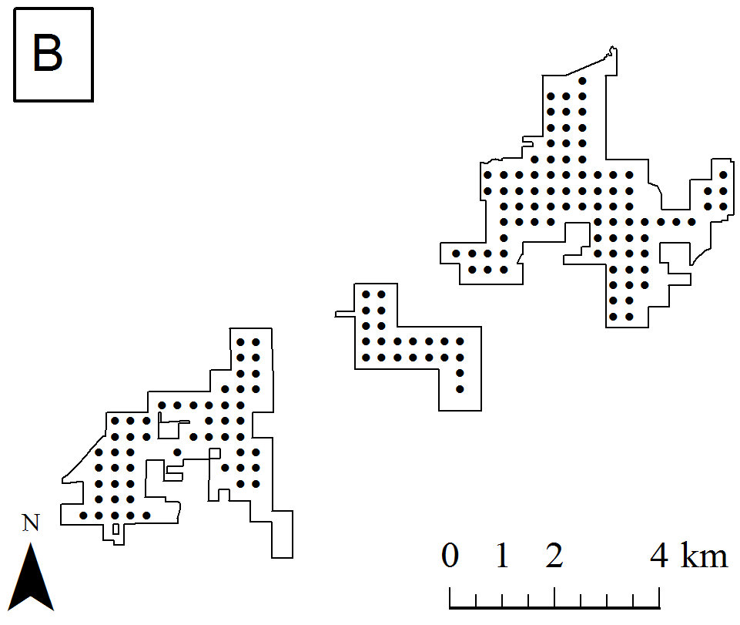
Bird Point Counts
Thousand Acres BCA
493 points
2016-2019
Two visits/year during breeding season
Distance sampling
4 bins
100 m truncation
10 minutes
No visual only or known female observations

Slide 10
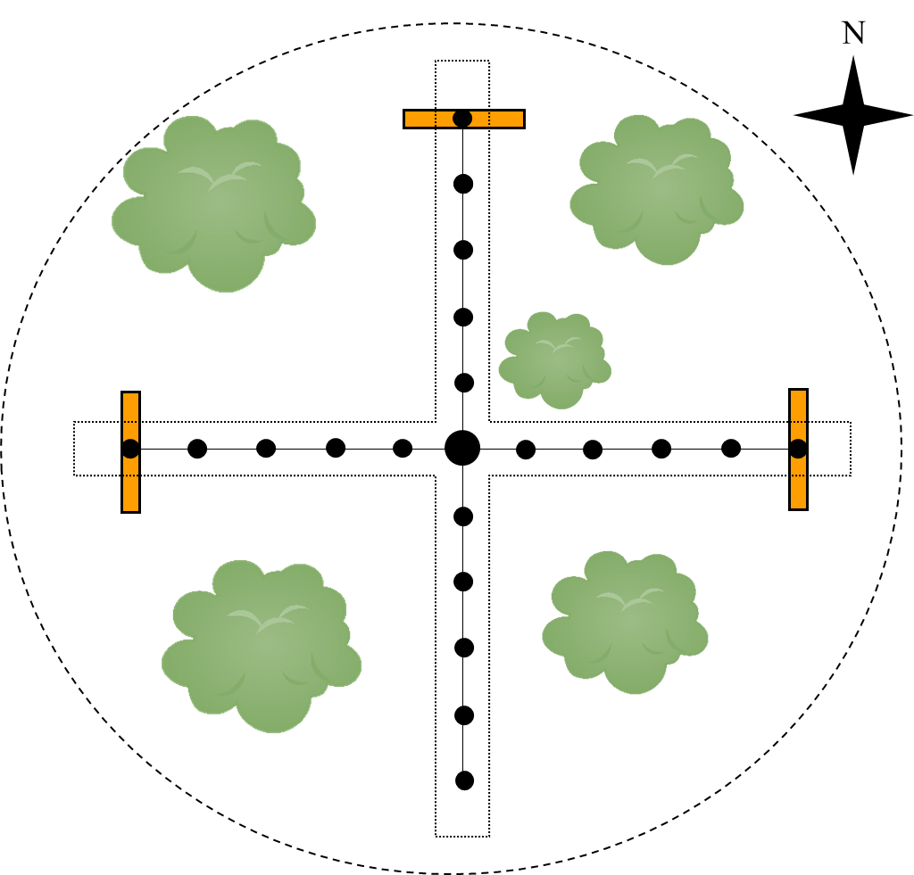
Vegetation Surveys
493 points (same as bird surveys)
July – August 2019 (single year)
Forestry prism sample, midstory photos, shrub stems, ground cover
Canopy closure not used
0 2 4 6 8 10
meters

Slide 11
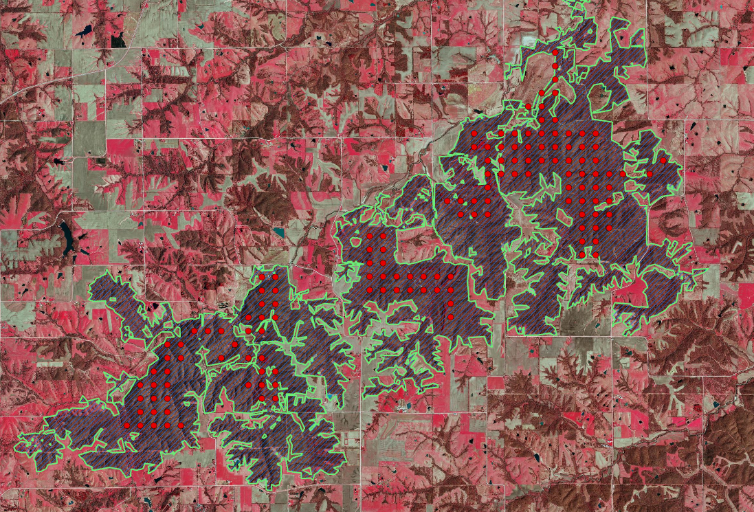
Landscape Scale Data
Cropscape data and ArcGIS used to estimate % forest cover within 1 and 10 km of point
Digitized 2016-2018 Iowa Spring Color Infrared Orthophotos to get forest patch boundaries

Slide 12
Hierarchical Distance Sampling
Estimate detection probability to get more accurate estimates of density
Hierarchical distance sampling (HDS) in R package ‘unmarked’
Individual species: Complex habitat characteristics directly in HDS models
Diversity: Simpler HDS models (fewer data), some species share a model
AIC-based model selection

Slide 13
Species diversity
Focused on species richness, but also calculated antilog Shannon-Weaver
Calculated species richness at each point for each year, then averaged across years
Estimated species richness from HDS models by summing occupancy probabilities
Linear regression against habitat metrics with AIC model selection

Slide 14
Habitat Hierarchy

Slide 15
1) LANDSCAPE SCALE
4) MIDSTORY
-Proportion forest in 1 km
-Proportion forest in 10 km
-Foliage density at 2.5 m
-Foliage density at 5 m
-Foliage density SD
2) EDGE EFFECTS
-Distance to edge
5) SHRUB AND GROUND
-Shrub stem density
-% grass cover
-% leaf litter cover
-% “green” ground cover
3) TREE CHARACTERISTICS
-Species richness
-Total live tree basal area
-Total dead tree basal area
-Proportion of basal area that is oak (proportion oak)

Slide 16
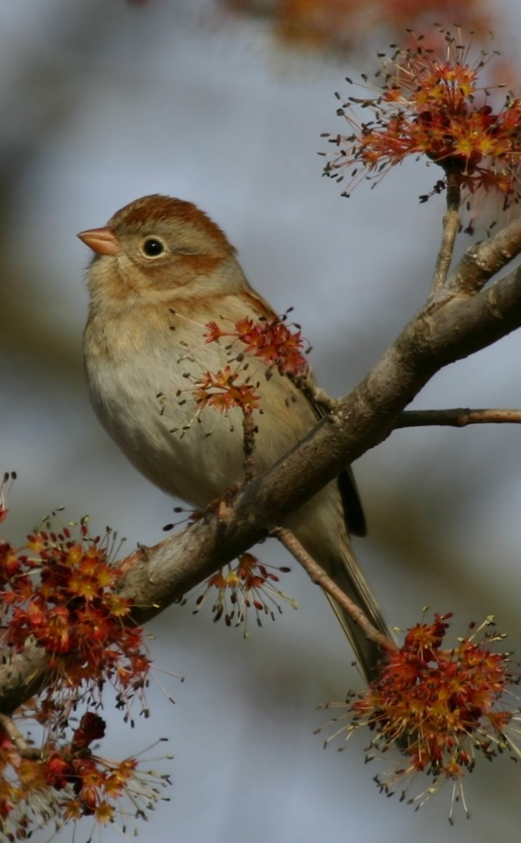
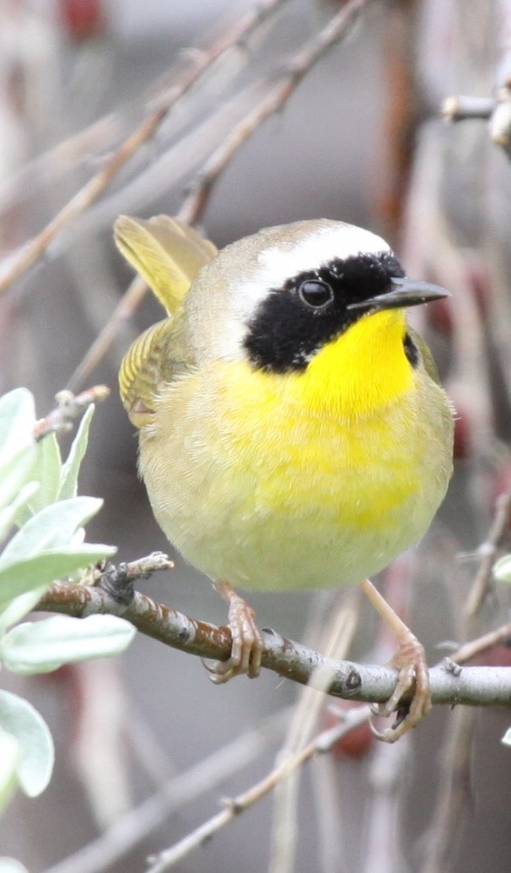
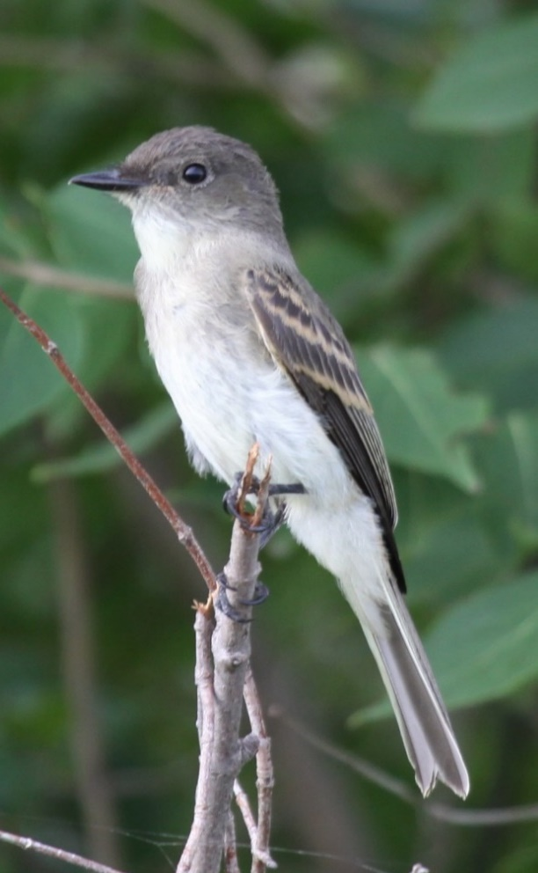
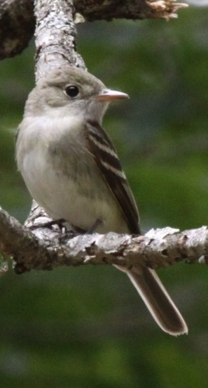
CHAPTER 2: HABITAT RELATIONSHIPS OF CONSERVATION PRIORITY BIRDS IN SOUTHERN IOWA FORESTS

Slide 17
Edges and
Early Successional
Mature Interior
Forest
Habitat Gradient
Field
Sparrow
Common
Yellowthroat
Eastern
Wood-Pewee
Acadian
Flycatcher

Slide 18
Edges and
Early Successional
Mature Interior
Forest
Habitat Gradient
*
*
Field
Sparrow
Common
Yellowthroat
Eastern
Wood-Pewee
Acadian
Flycatcher
* = only analyzed habitat at forest points

Slide 19
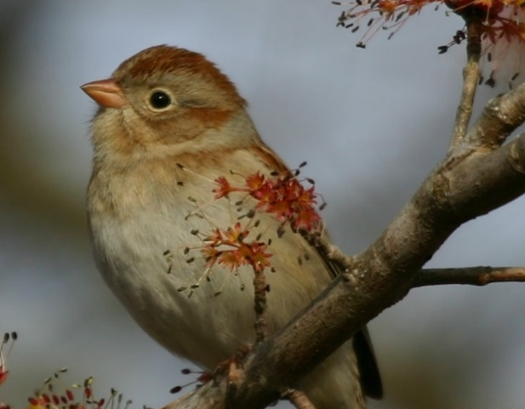
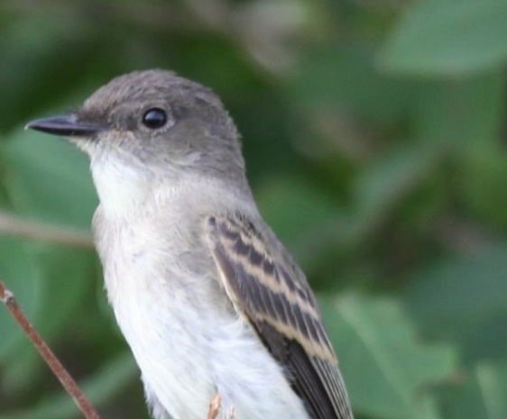
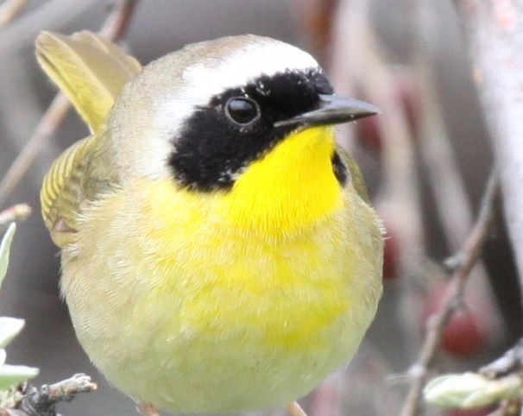
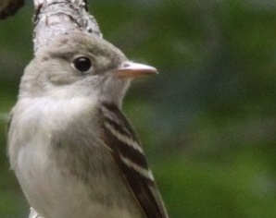
Landscape Metrics
Chapter 2 Results
-Forest in 10 km (-)
-Forest in 1 km (-)
(none)
Field Sparrow
Eastern
Wood-Pewee
-Forest in 10 km (+)
-Forest in 10 km (+)
Common Yellowthroat
Acadian Flycatcher

Slide 20
Distance to Edge
Chapter 2 Results
Strongly negative
Positive
Field Sparrow
Eastern
Wood-Pewee
Negative
Positive
Common Yellowthroat
Acadian Flycatcher

Slide 21
Point-Scale Vegetation Metrics
Chapter 2 Results
-Midstory 2.5 m (+)
-Grassy cover (+)
-Litter cover (+)
-Proportion oak (+)
-Litter cover (+)
Field Sparrow
Eastern
Wood-Pewee
-Green cover (+)
-Litter cover (-)
-Midstory 2.5 m (+)
-Shrub density (-)
-Litter cover (+)
Common Yellowthroat
Acadian Flycatcher

Slide 22
SGCN Maps
Chapter 2 Results

Slide 23
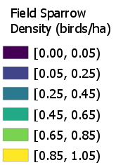
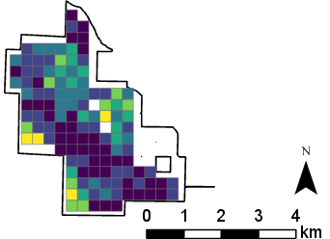
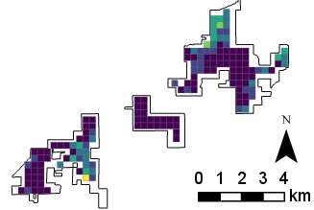
Sand Creek
(less forest)
Thousand Acres
(more forest)

Slide 24
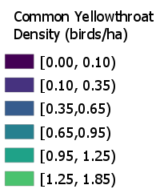
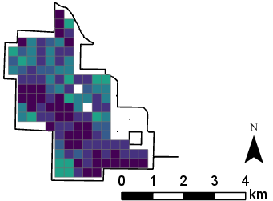
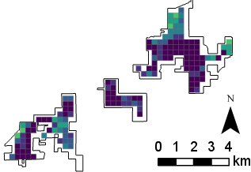
Sand Creek
(less forest)
Thousand Acres
(more forest)

Slide 25
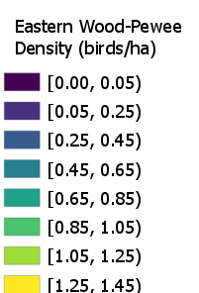
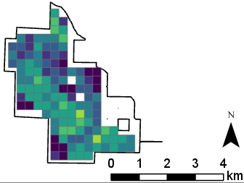
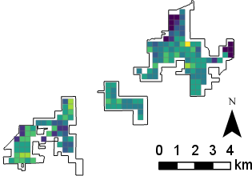
Sand Creek
(less forest)
Thousand Acres
(more forest)

Slide 26
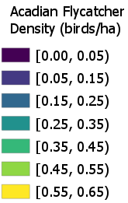
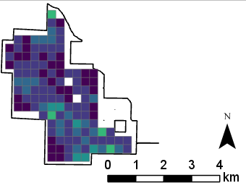
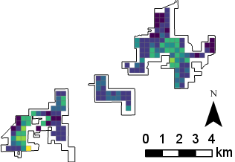
Sand Creek
(less forest)
Thousand Acres
(more forest)

Slide 27
Discussion
Chapter 2
Landscape and edge covariates important for most species
Prevalence of leaf litter in models surprising, especially for Field Sparrow
Site-level covariates are mostly species specific
No single management strategy for all species
Maintain interior forest for Acadian Flycatcher
Keep edge and open habitat for Field Sparrow
Maps will be useful for conservation planning (birding trail)

Slide 28
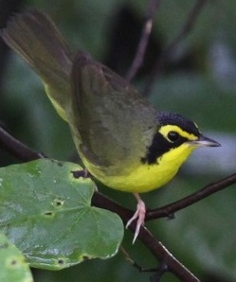
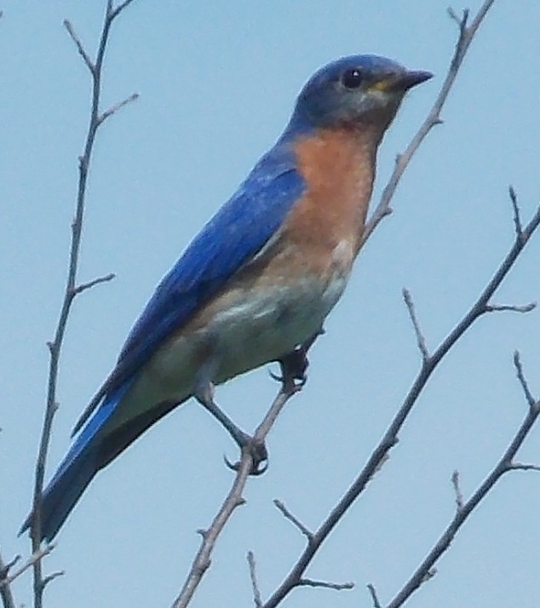
CHAPTER 3: BIRD DIVERSITY-HABITAT RELATIONSHIPS IN SOUTH-CENTRAL IOWA

Slide 29
Overall Diversity Summary
Chapter 3 Results
Modeled densities for 77 breeding species (excluded 49 additional species; migrants, ducks, owls, etc.)
Wide range of species-specific densities
0.001 birds/ha (Hooded Warbler)
0.860 birds/ha (Gray Catbird)
Median = 0.030 birds/ha
Point-scale species richness estimates ranged from 13.2 to 22.1
HDS species richness > “raw” species richness by 4.4 species on average

Slide 30
SGCN Diversity Summary
Chapter 3 Results
Found 25 breeding SGCN; excluded one (Horned Lark) due to only a single detection
Wide range of species-specific densities:
0.002 birds/ha (Veery and Cerulean Warbler)
0.566 birds/ha (Eastern Wood-Pewee)
Median = 0.016 birds/ha
Point-scale SGCN species richness estimates from HDS data ranged from 1.7 to 6.3
HDS SGCN species richness > “raw” SGCN species richness by 0.5 species on average

Slide 31
Species richness versus landscape
Chapter 3 Results
Overall: Positive relationship with forest at 10 km scale; increase in forest cover by 12% associated with one additional species
SGCN: both linear and quadratic coefficients for forest at 10 km scale, but an overall positive trend (see figure on next slide)
Both: forest at 1 km scale not in top model

Slide 32
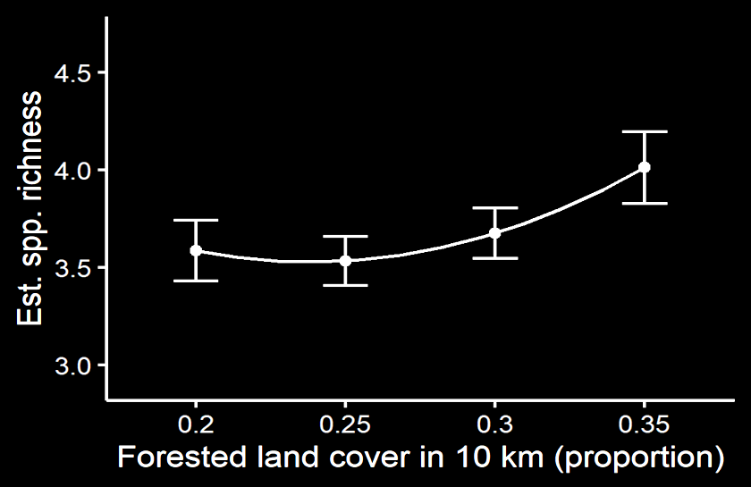
SGCN species richness versus landscape-scale forest cover
Chapter 3 Results

Slide 33
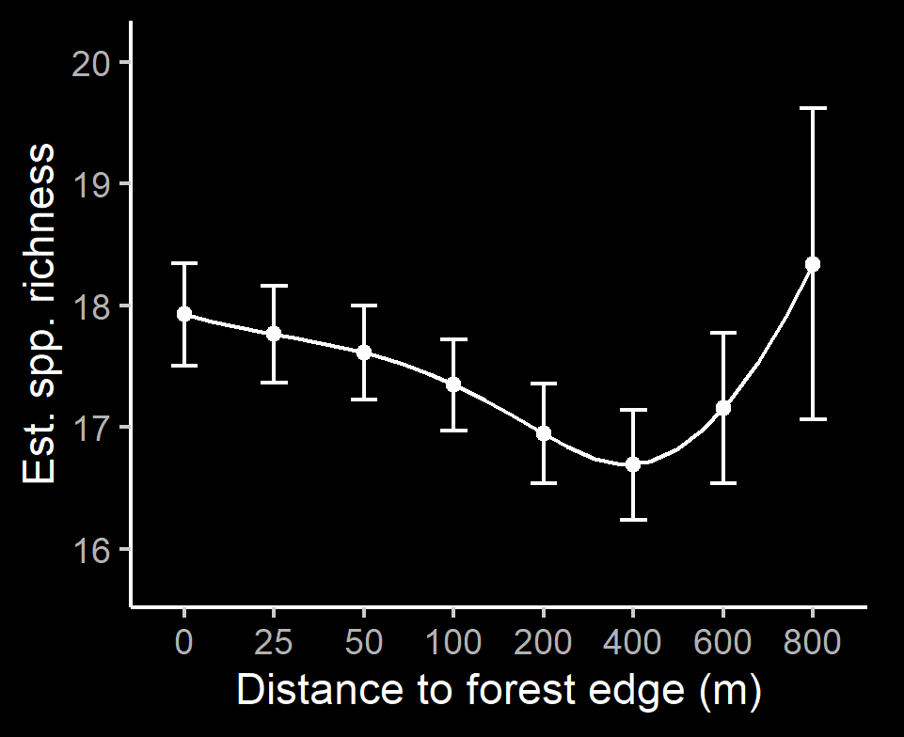
Overall species richness versus distance to edge
Chapter 3 Results

Slide 34
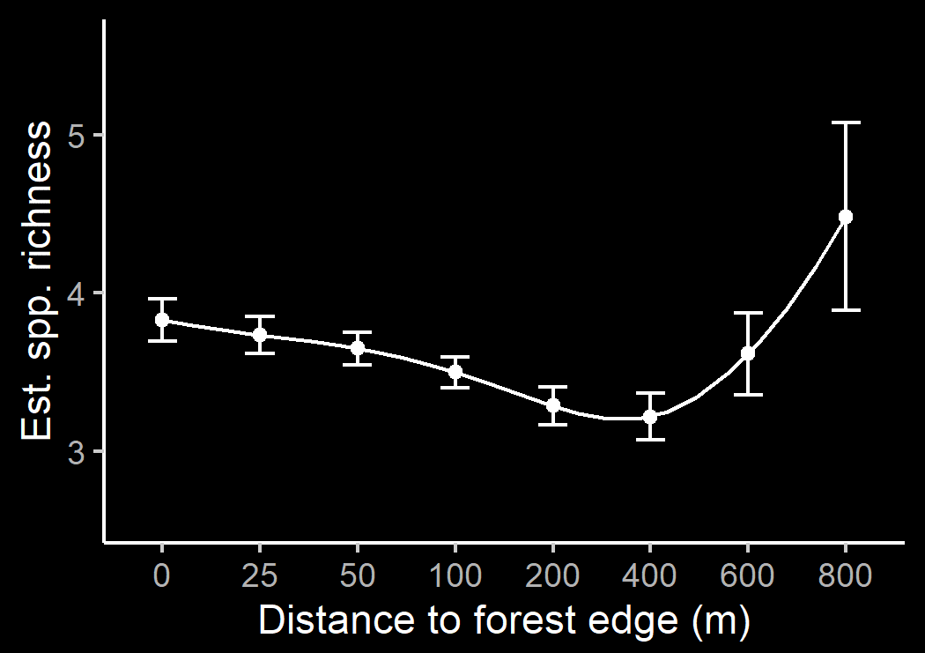
SGCN species richness versus distance to edge
Chapter 3 Results

Slide 35
Site-scale: Overall species richness
Chapter 3 Results
Positive association with tree species richness, ~7 additional tree species associated with one additional bird species
Negative association with midstory density at 5 m
Quadratic association with midstory SD; negative coefficient so “peak” at the mean value of midstory SD
Negative association with leaf litter cover (see next slide)

Slide 36
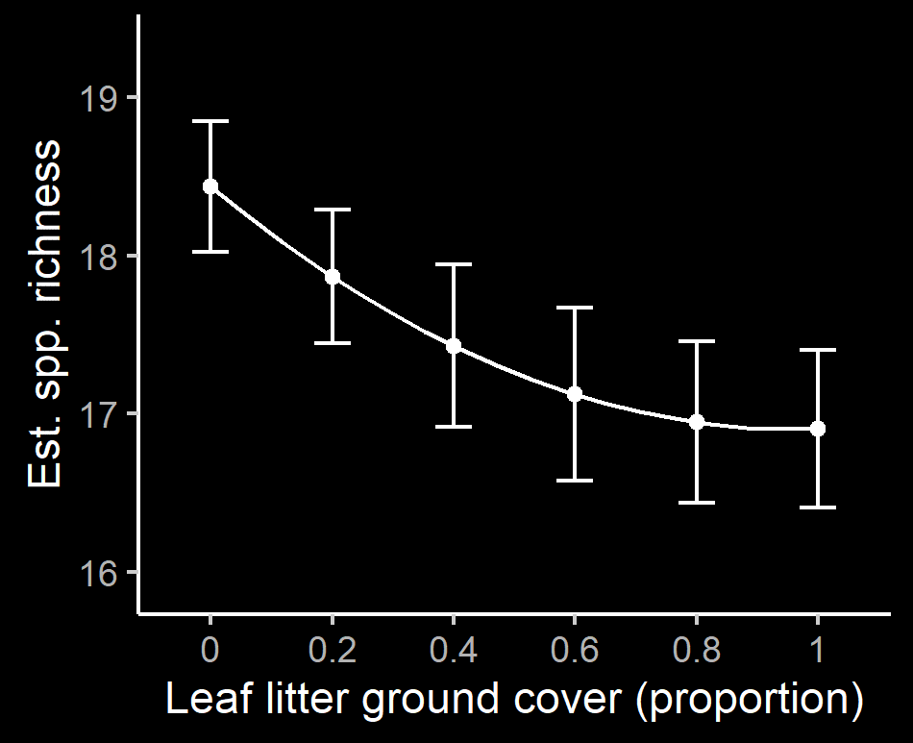
Overall species richness versus leaf litter cover
Chapter 3 Results

Slide 37
Site-scale: Overall species richness
Chapter 3 Results
Midstory density at 2.5 m, shrub density, grassy ground cover, and green ground cover all in top model, but...

Slide 38
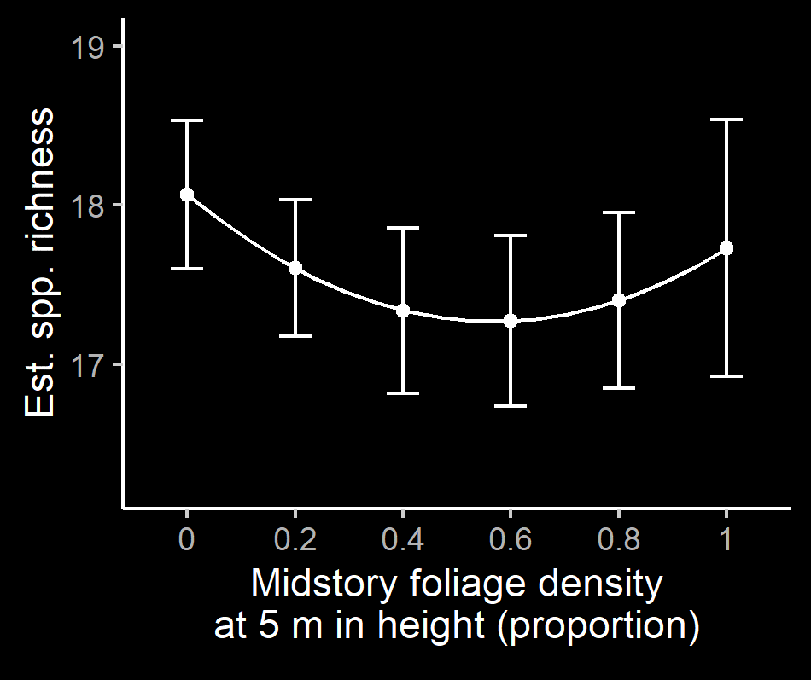
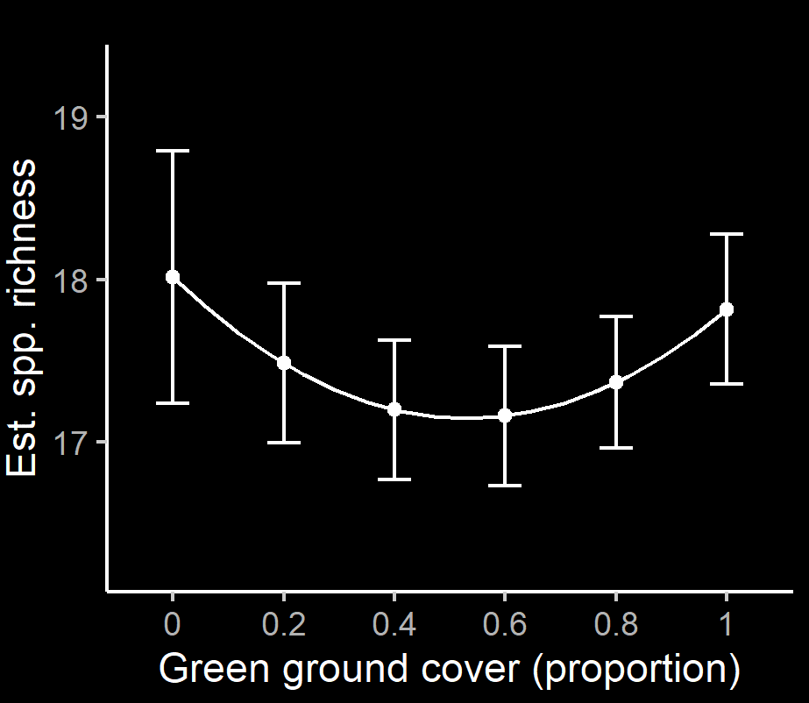
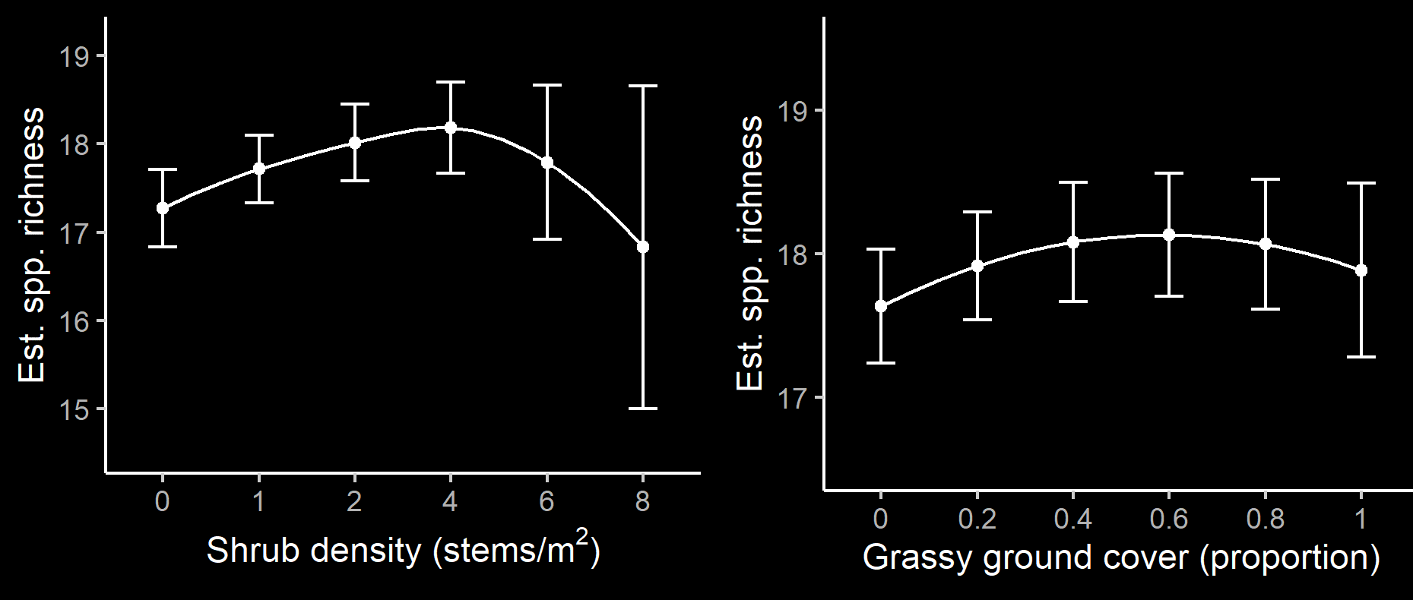
Chapter 3 Results

Slide 39
Site-scale: SGCN species richness
Chapter 3 Results
Weak associations with:
Midstory density at 5 m (-)
Grassy ground cover (+)
Leaf litter cover (-)

Slide 40
Species Richness Maps
Chapter 3 Results

Slide 41
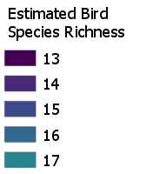
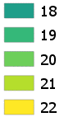
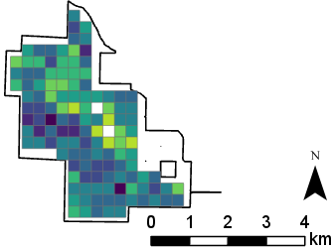
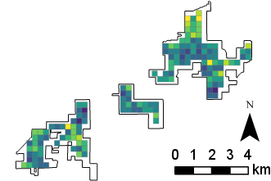
Sand Creek
(less forest)
Thousand Acres
(more forest)

Slide 42
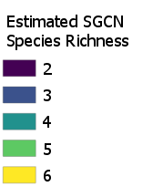
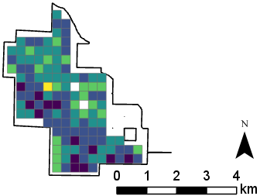
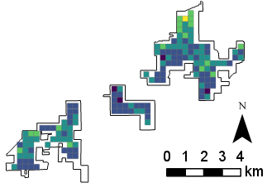
Sand Creek
(less forest)
Thousand Acres
(more forest)

Slide 43
Discussion
Chapter 3
Large number of bird species (including SGCN) breed in our study area
Accounting for imperfect detection probability produced higher estimates of species richness
Landscape scale forest cover and distance to edge important for diversity
Forest edges and interior forest are both diverse

Slide 44
Discussion (cont.)
Chapter 3
Maintaining tree species diversity within a stand benefits bird diversity
Negative midstory relationships hard to interpret; more midstory generally means more structure and habitat
Negative relationship with leaf litter means leaf litter is likely an indicator of another habitat characteristic, such as canopy closure

Slide 45
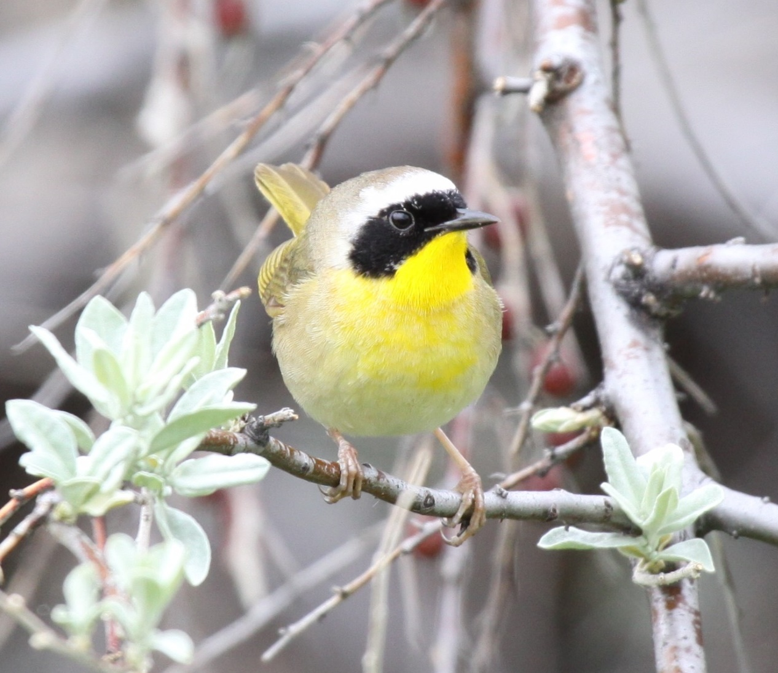
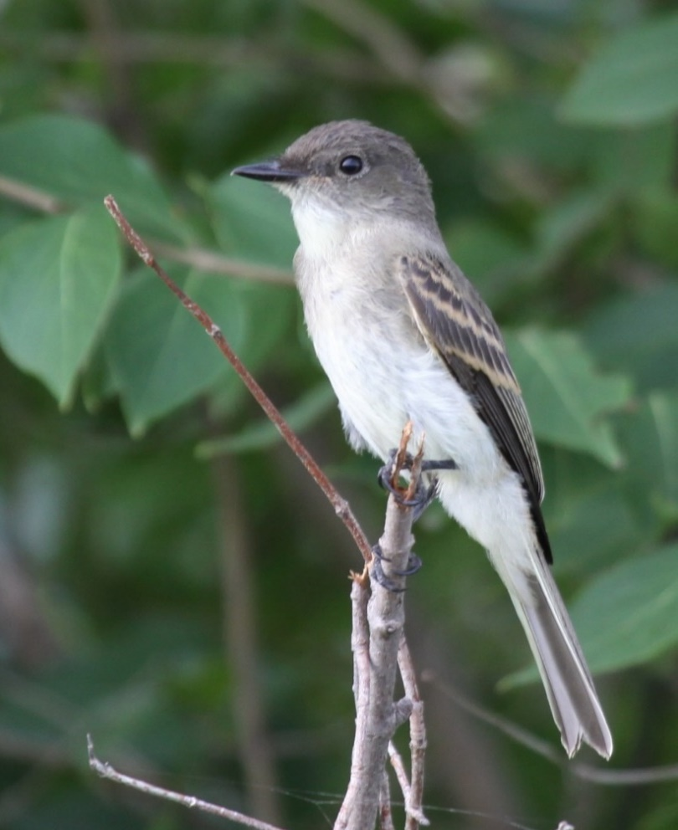
Conclusions & Impacts

Slide 46
Conclusions and Impacts
High landscape scale forest cover benefits most species and overall bird diversity; private lands play a vital role
Interior forests with minimal edge are an important habitat, especially to SGCN, and should be conserved
Edge and open habitat needed for some species
Findings can be applied in management (e.g., avoid creating edges near interior forest)
How do we prioritize future forest disturbance in a working forest?
Maps will be used by local organizations to create a birding trail

Slide 47
Acknowledgements
Funding: U.S. Forest Service (USDA), Iowa Department of Natural Resources, and McIntire-Stennis Capacity Grant (USDA)
Committee: Stephen J. Dinsmore, Peter T. Wolter, Philip M. Dixon
Planning and logistics: Paul Tauke, Jessica Flatt, Jeff Goerndt, Kevin T. Murphy, and Rachel A. Vanausdall
Technicians: Jesse Beck, Joe Cicero, Mark Edwards, Sonia Howlett, Connor Langan, Kevin T. Murphy, Jacob Newton, Logan Hatfield
Research IT
Many others, including friends, colleagues, professors, and my family
Images: BCA Map from the Iowa Department of Natural Resources

Slide 48
Questions?

